Slide 1

ISTIO SERVICE MESH: DEPLOYMENT, ARCHITECTURE, AND ANALYSIS
By, Thirumavalavan M
TM

Slide 2
Introduction to Istio Service Mesh
What is a service mesh?
Benefits of Istio
A service mesh is a dedicated infrastructure layer that provides a transparent way to control and manage the communication between microservices.
Istio offers powerful capabilities including traffic management, security, observability, and fault tolerance, making it easier to manage and operate microservices.

Slide 3
Istio Architecture: Data Plane and Control Plane
Data Plane
Control Plane
The data plane consists of Envoy proxies deployed alongside each microservice. Envoy handles all incoming and outgoing traffic for the service.
The control plane manages the configuration and behavior of the data plane. It includes components like Istiod, Mixer, and Pilot.

Slide 4
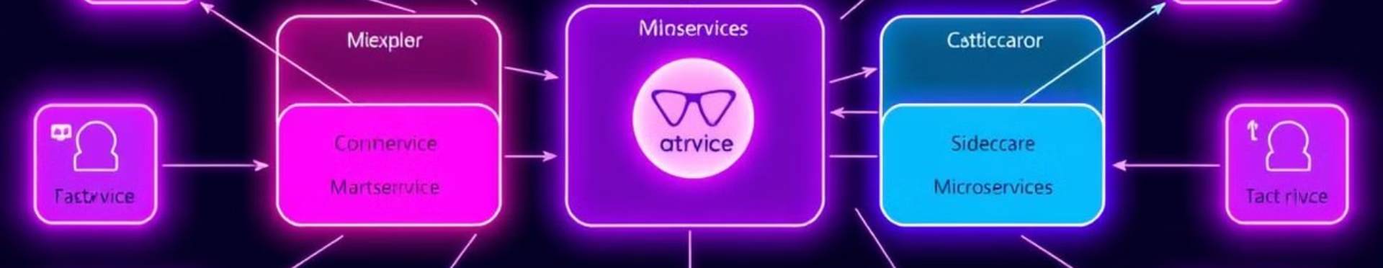
Istiod: The Brains of the Control Plane
Centralized Control
Policy Enforcement
Telemetry Collection
Istiod provides a single point of control for managing the entire Istio service mesh.
It enforces security policies, traffic routing rules, and other configuration settings across the mesh.
Istiod gathers metrics, traces, and logs from the data plane, providing valuable insights into the health and performance of the mesh.

Slide 5
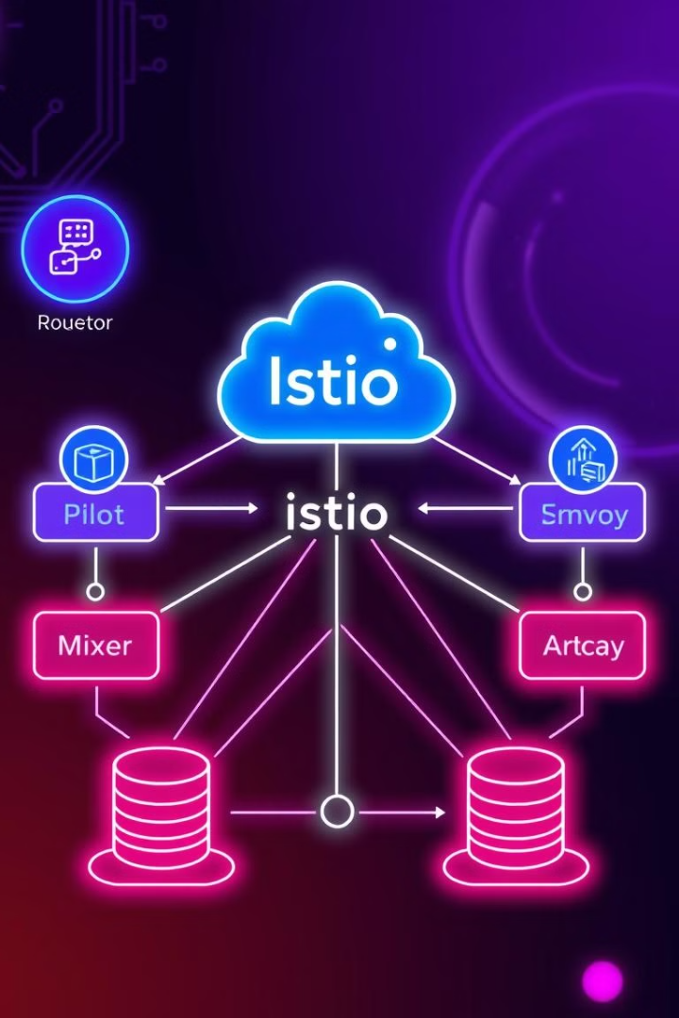


Istio Service Discovery and Configuration Management
Service Discovery
Configuration Management
Istio uses Kubernetes as its primary service discovery mechanism, automatically detecting and registering services in the mesh.
Istio allows you to configure and manage traffic policies, security settings, and other aspects of the mesh using configuration files or a dedicated UI.

Slide 6
Istio Security Features: mTLS and Authorization
Mutual TLS (mTLS)
Authorization
Istio enforces mTLS by default, ensuring that all communication within the mesh is encrypted and authenticated.
Istio provides robust authorization policies, allowing you to control access to services based on user identities, service roles, and other factors.

Slide 7




Istio Traffic Management: Routing, Load Balancing, Resiliency
Traffic Routing
Load Balancing
Resiliency
Istio allows you to dynamically route traffic between different versions of services, enabling canary deployments and A/B testing.
Istio provides various load balancing algorithms, ensuring that traffic is distributed evenly across instances of a service.
Istio offers features like circuit breakers and retries to enhance the resilience of microservices and handle failures gracefully.

Slide 8
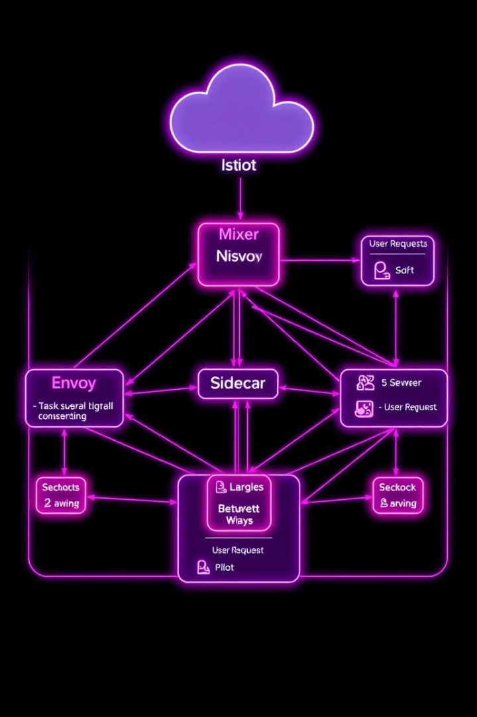
Istio Observability: Metrics, Tracing, and Logging
1
2
Metrics
Tracing
Istio provides rich metrics on service performance, traffic patterns, and resource utilization.
Istio integrates with distributed tracing systems, allowing you to track requests across the mesh.
3
Logging
Istio allows you to collect and analyze logs from the data plane, providing valuable insights into service behavior.

Slide 9
Istio Deployment Models and Best Practices
Kubernetes Integration
1
Istio integrates seamlessly with Kubernetes, leveraging its features for service discovery, deployment, and resource management.
Deployment Options
2
Istio can be deployed in various ways, including sidecar injection, manual deployment, and Istio operator.
Best Practices
3
Follow recommended practices for managing configuration, security, and monitoring to maximize Istio's benefits.

Slide 10
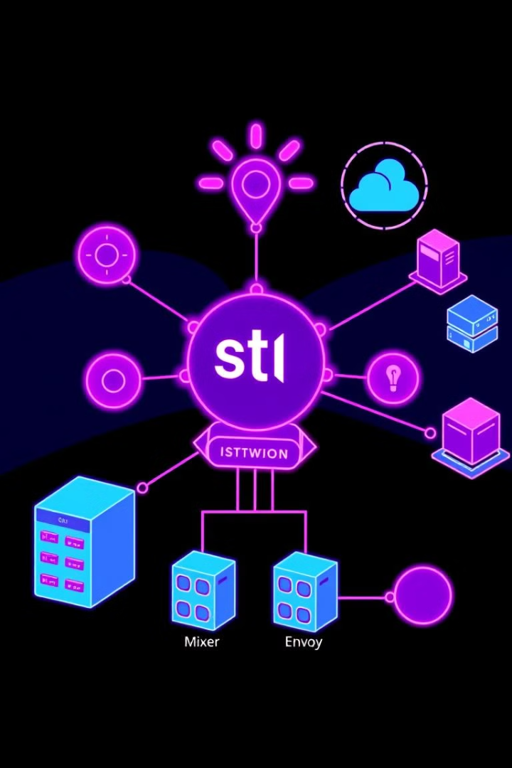
Conclusion and Key Takeaways
Istio provides a robust and comprehensive solution for managing microservices. By simplifying traffic management, security, observability, and fault tolerance, Istio empowers developers to build and operate microservices effectively.

